Slide 1
Queues

Slide 2
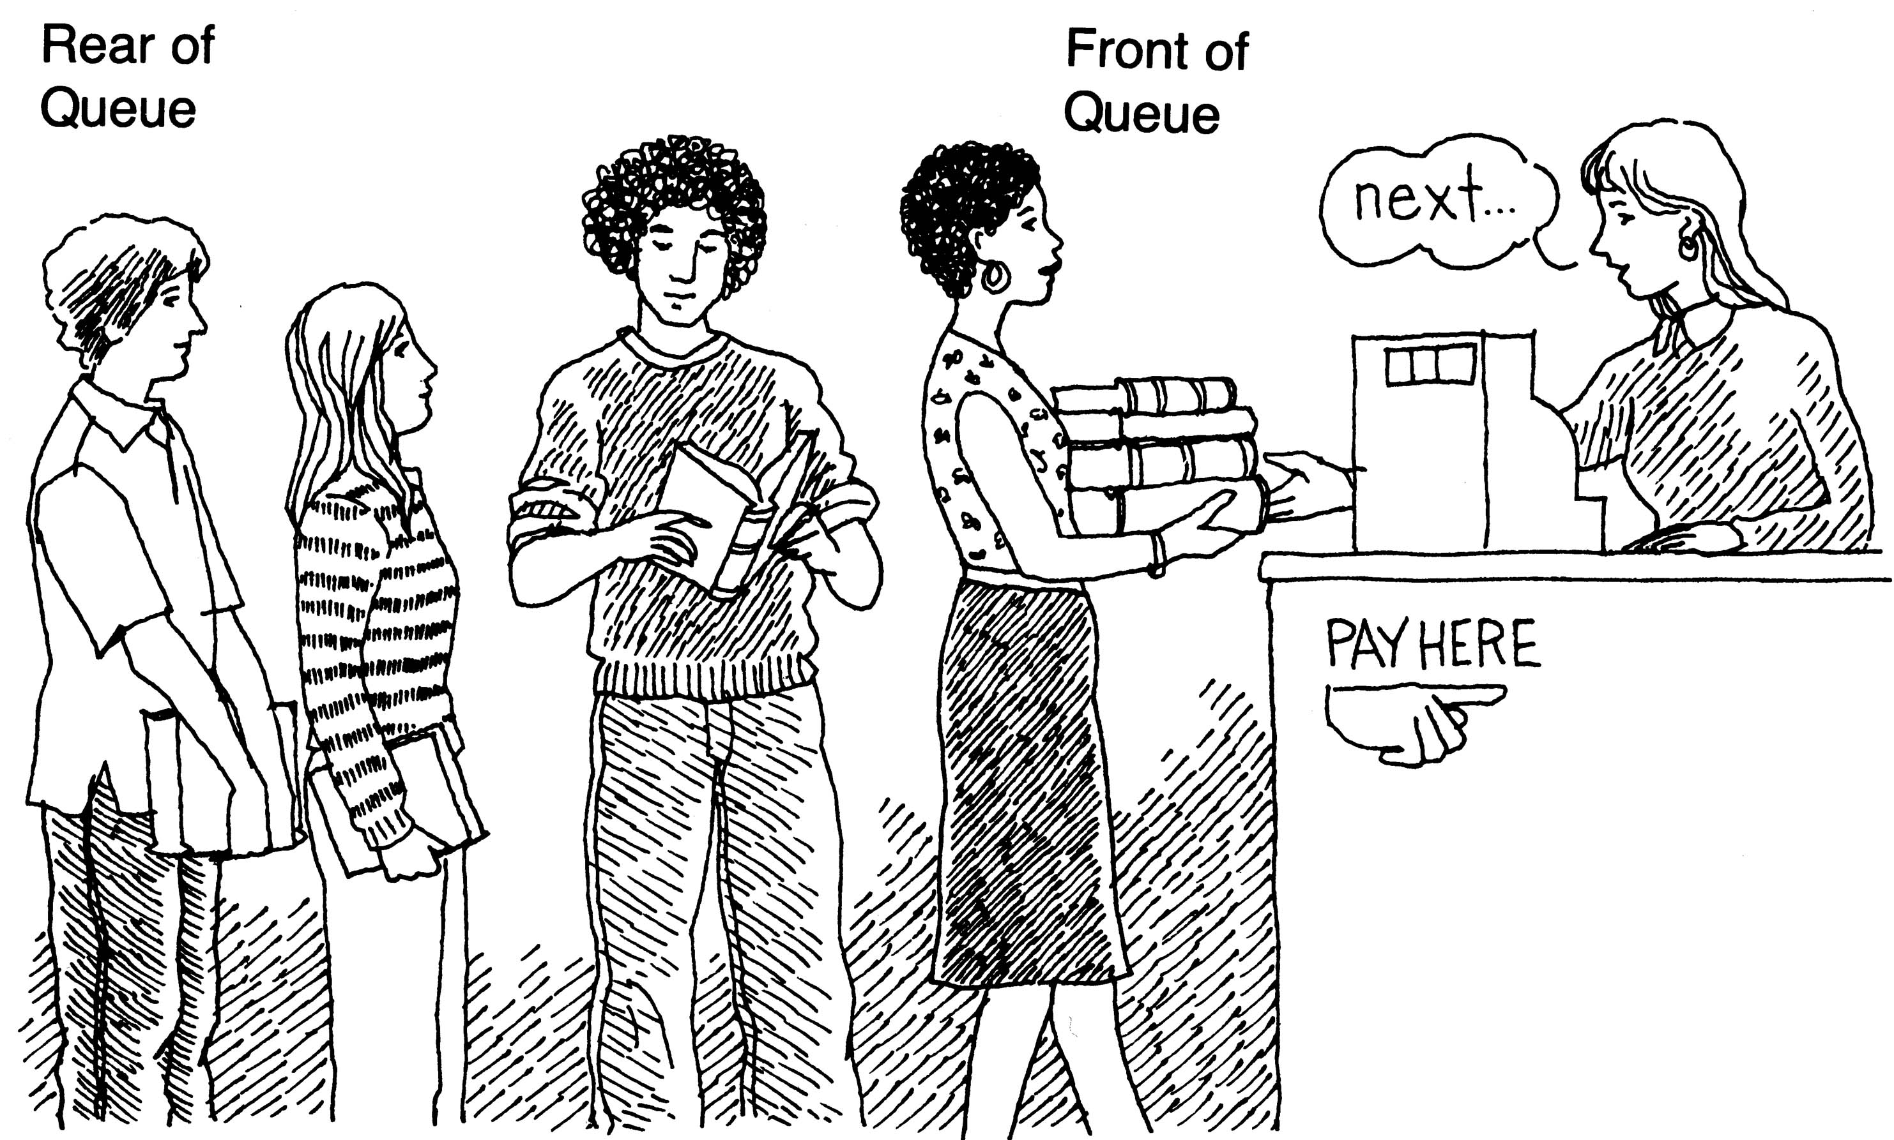
What is Queue? (ADT)
It is an ordered group of homogeneous items
Queues have two ends:
Elements are added at one end
Elements are removed from the other end
The element added first is also removed first (FIFO: First In, First Out)

Slide 3
Application
CPU scheduling
Handling of interrupts in real-time systems
Breadth-First Search (BFS) in graph algorithms
Call Centers
Request Handling
Streaming

Slide 4
Queue Operations
Enqueue(): Inserting an element into queue
Dequeue(): Deleting an element from the queue
Isfull(): Check if the queue is full or not
IsEmpty(): Check if the queue is empty or not
Display(): Display the contents of the queue
other functions
Size(), front(), rear();

Slide 5
Types of Queues
Simple/Linear Queue
Circular Queue
Double ended queue
Priority Queue

Slide 6
Array based implementation- Version 1
items[MAX_SIZE]: Array to store queue elements
front and rear: Indices to track the front and rear of the queue
Initial State
front = -1
rear = -1

Slide 7
sEmpty() Function
int isEmpty() {
return (front == -1 && rear == -1);
}
Checks to determine if the queue is empty.
Condition return (front == -1 && rear == -1);
Returns 1 (true) if the queue is empty.
Returns 0 (false) otherwise.

Slide 8
isFull() Function
int isFull() {
return (rear == MAX_SIZE - 1);
}
Checks if rear has reached MAX_SIZE - 1 to determine if the queue is full.
Condition return (rear == MAX_SIZE - 1);
Returns 1 (true) if the queue is full.
Returns 0 (false) otherwise.

Slide 9
enqueue() Function
void enqueue(int value) {
if (isFull()) {
printf("Queue is full. Cannot enqueue.\n");
return;
} else if (isEmpty()) {
front = 0;
rear = 0;
} else {
rear++;
}
items[rear] = value;
}
Conditions
Check if Full
if (isFull())
Prints "Queue is full" message and returns.
Check if Empty
else if (isEmpty())
Sets front and rear to 0.
Increment Rear
else
Increments rear.
Add Element
items[rear] = value;

Slide 10
dequeue() Function
int dequeue() {
int removed;
if (isEmpty()) {
printf("Queue is empty. Cannot dequeue.\n");
return -1;
} else if (front == rear) {
removed = items[front];
front = -1;
rear = -1;
} else {
removed = items[front];
front++;
}
return removed;
}
Conditions
Check if Empty
if (isEmpty())
Prints "Queue is empty" message and returns -1.
Check if Only One Element
else if (front == rear)
Removes the element and resets front and rear to -1.
Increment Front
else
Removes the element and increments front.

Slide 11
getFront()
int getFront() {
if (isEmpty()) {
printf("Queue is empty.\n");
return -1;
}
return items[front];
}
Conditions
Check if Empty
if (isEmpty())
Prints "Queue is empty" message and returns -1.
Return Front Element
return items[front];

Slide 12
display() Function
void display() {
if (isEmpty()) {
printf("Queue is empty.\n");
return;
}
printf("Queue elements are:\n");
for (int i = front; i <= rear; i++) {
printf("%d ", items[i]);
}
printf("\n");
}
ConditionsCheck if Empty
if (isEmpty())
Prints "Queue is empty" message and returns.
Print Elements
for (int i = front; i <= rear; i++)
Iterates from front to rear and prints each element.

Slide 13
int main() {
enqueue(10);
enqueue(20);
enqueue(30);
enqueue(40);
display(); // Output: Queue elements are: 10 20 30 40
printf("Dequeued element: %d\n", dequeue()); // Output: Dequeued element: 10
display(); // Output: Queue elements are: 20 30 40
printf("Front element: %d\n", getFront()); // Output: Front element: 20
return 0;
}

Slide 14
Version 2 implementation
Shifting Elements to Avoid Resetting Indices
Shifting Elements: This version avoids resetting the front and rear indices by shifting elements to the front of the array after each dequeue operation.
Conditions for Empty Queue:front remains at 0, and rear indicates the number of elements in the queue.
Dequeue Operation:When an element is dequeued, all remaining elements in the queue are shifted one position to the left.
rear is decremented to reflect the new size of the queue.

Slide 15
Version 2:
Enqueue:
Initial State: front = 0, rear = 0
After Enqueue 1: front = 0, rear = 1
After Enqueue 2: front = 0, rear = 2
Dequeue:
After Dequeue 1: front = 0, rear = 1 (shifts elements)
After Dequeue 2: front = 0, rear = 0 (queue becomes empty)

Slide 16
Handling Empty Queue:
Version 1: Resets front and rear to -1 to signify an empty queue.
Version 2: Keeps front at 0 and uses rear to track the number of elements, avoiding resetting indices.
Dequeue Operation:
Version 1: Simple removal with condition to reset indices when the queue becomes empty.
Version 2: Involves shifting elements left after each dequeue to maintain queue structure.
Complexity:
Version 1: Potentially more complex state management due to resetting indices.
Version 2: Simplifies state management by maintaining indices but may incur performance cost due to shifting elements.

Slide 17
Version 1:
Enqueue:
Initial State: front = -1, rear = -1
After Enqueue 1: front = 0, rear = 0
After Enqueue 2: front = 0, rear = 1
Dequeue:
After Dequeue 1: front = 1, rear = 1
After Dequeue 2 (empty): front = -1, rear = -1

Slide 18
Limitation of simple queue
In linear queue, once we reach MAXSIZE-1, further elements can not be added eventhough there are free locations in the front.
Wastage of space – arrays
Inefficient space usage when elements are dequeued.
Solution:
Shifting element to the left on each deque(Version 2 implementation)
Circular queue

Slide 19
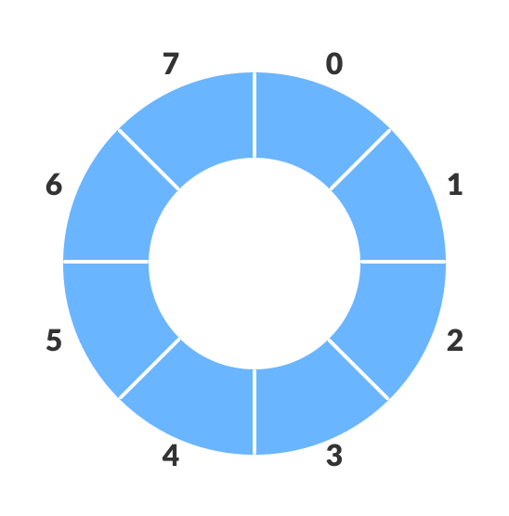
Circular Queue
A circular queue is a linear data structure in which the last position is connected back to the first position to form a circle.
Circular Queue works by the process of circular increment i.e., when we try to increment the index and we reach the end of the queue, we start from the beginning of the queue

Slide 20
Circular Queue Core Operations:
Enqueue: Add an element to the queue.
Dequeue: Remove an element from the queue.
Front: View the element at the front.
IsEmpty: Check if the queue is empty.
IsFull: Check if the queue is full.

Slide 21
Implementation of Circular Queue
Initial Condition:
int front = -1;
int rear = -1;
Both front and rear are initialized to -1, indicating that the queue is empty.

Slide 22
Implementation of Circular Queue
Adding element into Circular Queue – Enqueue
void enqueue(int item) {
if ((rear + 1) % MAX == front) {
printf("Queue is Full\n");
return;
}
if (front == -1) {
front = 0;
}
rear = (rear + 1) % MAX;
queue[rear] = item;
}
rear = (rear + 1) % MAX
Moves the rear pointer to the next position in the circular queue. The modulo operation ensures the pointer wraps around to the start of the array if needed.

Slide 23
Dequeue()
int dequeue() {
if (front == -1) {
printf("Queue is Empty\n");
return -1;
}
int item = queue[front];
if (front == rear) {
front = rear = -1;
} else
{
front = (front + 1) % MAX;
}
return item;
}
Condition: if (front == rear)
Checks if the queue has only one element left. If true, it resets both front and rear to -1, indicating the queue will be empty after this operation.
Condition: front = (front + 1) % MAX
Moves the front pointer to the next position in the circular queue. The modulo operation ensures the pointer wraps around to the start of the array if needed.

Slide 24
Front()
int front() {
if (front == -1) {
printf("Queue is Empty\n");
return -1;
}
return queue[front];
}

Slide 25
isEmpty()
int isEmpty() {
return front == -1;
}
int isFull() {
return (rear + 1) % MAX == front;
}

Slide 26
Conditions in Circular Queue
Empty Queue Condition:front == -1
Full Queue Condition:(rear + 1) % MAX == front
Reset Condition: After dequeuing the last element, reset both front and rear to -1.

Slide 27
Advantages of Circular Queue
Space Efficiency: No wasted space as the queue wraps around.
Time Complexity: Enqueue and dequeue operations are constant time, O(1).
Implementation Simplicity: Easy to implement using arrays.
Summary:
Circular queues efficiently utilize space compared to linear queues.
Simple operations with constant time complexity.
Widely used in various practical applications.

Slide 28
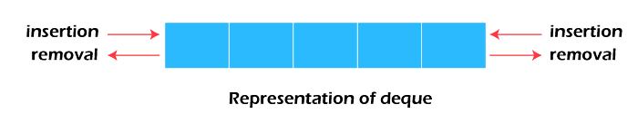
Double ended queue (Deque)
Double Ended Queue (Deque): is a type of queue in which insertion and deletion of elements can be performed in both ends. It can act as both a queue (FIFO) and a stack (LIFO).
It does not strictly follow FIFO rule.

Slide 29
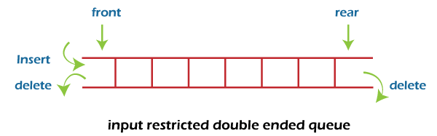
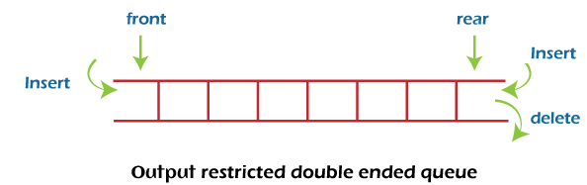
Types of Deques
Input-Restricted Deque: Only one end is open for insertion, both ends are open for deletion.
Output-Restricted Deque: Only one end is open for deletion, both ends are open for insertion.

Slide 30
Basic Operations on Deques
Insertion:
insertFront(x): Insert element x at the front.
insertRear(x): Insert element x at the rear.
Deletion:
deleteFront(): Remove element from the front.
deleteRear(): Remove element from the rear.
Access:
getFront(): Access the front element.
getRear(): Access the rear element.
Check Full/Empty:
isFull(): Check if deque is full.
isEmpty(): Check if deque is empty.

Slide 31
void insertFront(int x) {
if ((front == 0 && rear == SIZE - 1) || (front == rear + 1)) {
printf("Deque is full!\n");
return;
}
if (front == -1) {
front = rear = 0;
} else if (front == 0) {
front = SIZE - 1;
} else {
front = front - 1;
}
deque[front] = x;
printf("Inserted %d at front\n", x);
}
#include <stdio.h>
#define SIZE 10
int deque[SIZE];
int front = -1, rear = -1;

Slide 32
void insertRear(int x) {
if ((front == 0 && rear == SIZE - 1) || (front == rear + 1)) {
printf("Deque is full!\n");
return;
}
if (front == -1) {
front = rear = 0;
} else if (rear == SIZE - 1) {
rear = 0;
} else {
rear = rear + 1;
}
deque[rear] = x;
printf("Inserted %d at rear\n", x); }

Slide 33
void deleteFront() {
if (front == -1) {
printf("Deque is empty!\n");
return;
}
printf("Deleted %d from front\n", deque[front]);
if (front == rear) {
front = rear = -1;
} else if (front == SIZE - 1) {
front = 0;
} else {
front = front + 1;
}}

Slide 34
void deleteRear() {
if (front == -1) {
printf("Deque is empty!\n");
return;
}
printf("Deleted %d from rear\n", deque[rear]);
if (front == rear) {
front = rear = -1;
} else if (rear == 0) {
rear = SIZE - 1;
} else {
rear = rear - 1;
}
}
int main() {
insertFront(10);
insertRear(20);
deleteFront();
deleteRear();
return 0;
}

Slide 35
Priority Queue
An abstract data type where each element is associated with a priority. Elements are served based on priority, not just the order in which they arrive.
An element with high priority is dequeued before an element with low priority.
If two elements have the same priority, they are served according to their order in the queue.
Real-World Examples:
Emergency Room: Treating patients based on the severity of their condition.
Task Scheduling: Executing tasks based on their importance.

Slide 36
Types of Priority Queues
Ascending Priority Queue (Min-Priority Queue):
Elements with the lowest priority are dequeued first.
Descending Priority Queue (Max-Priority Queue):
Elements with the highest priority are dequeued first.

Slide 37
Array-Based Implementation
Unsorted Array: Simple insertion, complex deletion.
Sorted Array: Complex insertion, simple deletion.
Basic Operations:
Insertion (Enqueue): Add element to array.
Deletion (Dequeue): Remove the element with the highest/lowest priority.
Peek: Access the highest/lowest priority element without removing it.

Slide 38
Unsorted Array
Insertion in Unsorted Array:
Add the new element to the end of the array.Time Complexity: O(1)
Deletion in Unsorted Array:
Search the array for the element with the highest (or lowest) priority.
Remove that element and shift the remaining elements.
Time Complexity: O(n)

Slide 39
Sorted Array
Insertion in Sorted Array:
Locate the correct position in the array to maintain sorted order.
Shift elements to the right to make space for the new element.
Insert the new element at its correct position.
Time Complexity: O(n) – since you may need to shift elements to maintain the sorted order.
Deletion in Sorted Array:
Since the array is sorted, the highest (or lowest) priority element is already at the beginning or end of the array.
Simply remove the element from the front (for min-priority) or back (for max-priority) of the array.
No need to search for the element since it's already in place.
Shift remaining elements if needed (only when removing from the front).
Time Complexity: O(1) – since the element is easily accessible, but shifting may require O(n) in some cases.

Slide 40
#include <stdio.h>
#include <limits.h>
#define MAX 100
int priorityQueue[MAX];
int size = 0;
void insert(int element) {
if (size == MAX) {
printf("Queue is full!\n");
return;
}
priorityQueue[size++] = element;
}

Slide 41
int deleteMax() {
if (size == 0) {
printf("Queue is empty!\n");
return INT_MIN;
}
int maxIndex = 0;
for (int i = 1; i < size; i++) {
if (priorityQueue[i] > priorityQueue[maxIndex]) {
maxIndex = i;
}
}
int maxElement = priorityQueue[maxIndex];
for (int i = maxIndex; i < size - 1; i++) {
priorityQueue[i] = priorityQueue[i + 1];
}
size--;
return maxElement;
}

Slide 42
void display() {
if (size == 0) {
printf("Queue is empty!\n");
return;
}
for (int i = 0; i < size; i++) {
printf("%d ", priorityQueue[i]);
}
printf("\n");
}
int main() {
insert(4);
insert(2);
insert(5);
insert(3);
printf("Priority Queue: ");
display();
printf("Max Element: %d\n", deleteMax());
printf("Priority Queue after deletion: ");
display();
return 0;
}

Slide 43
Using one structure
Single structure for both elements and their priorities.
typedef struct {
int value;
int priority;
} Item;
// Global array to store the elements of the priority queue
Item pr[MAX_SIZE];

Slide 44
Using Two Structures
typedef struct {
int value;
int priority;
} Element;
typedef struct {
Element elements[MAX_SIZE];
int size;
} PriorityQueue;

Slide 45
Alternative Implementations
There are more efficient ways to implement priority queues:
Heaps: More efficient for large datasets.
Balanced Trees: Maintain sorted order with better time complexities.

